Slide 1
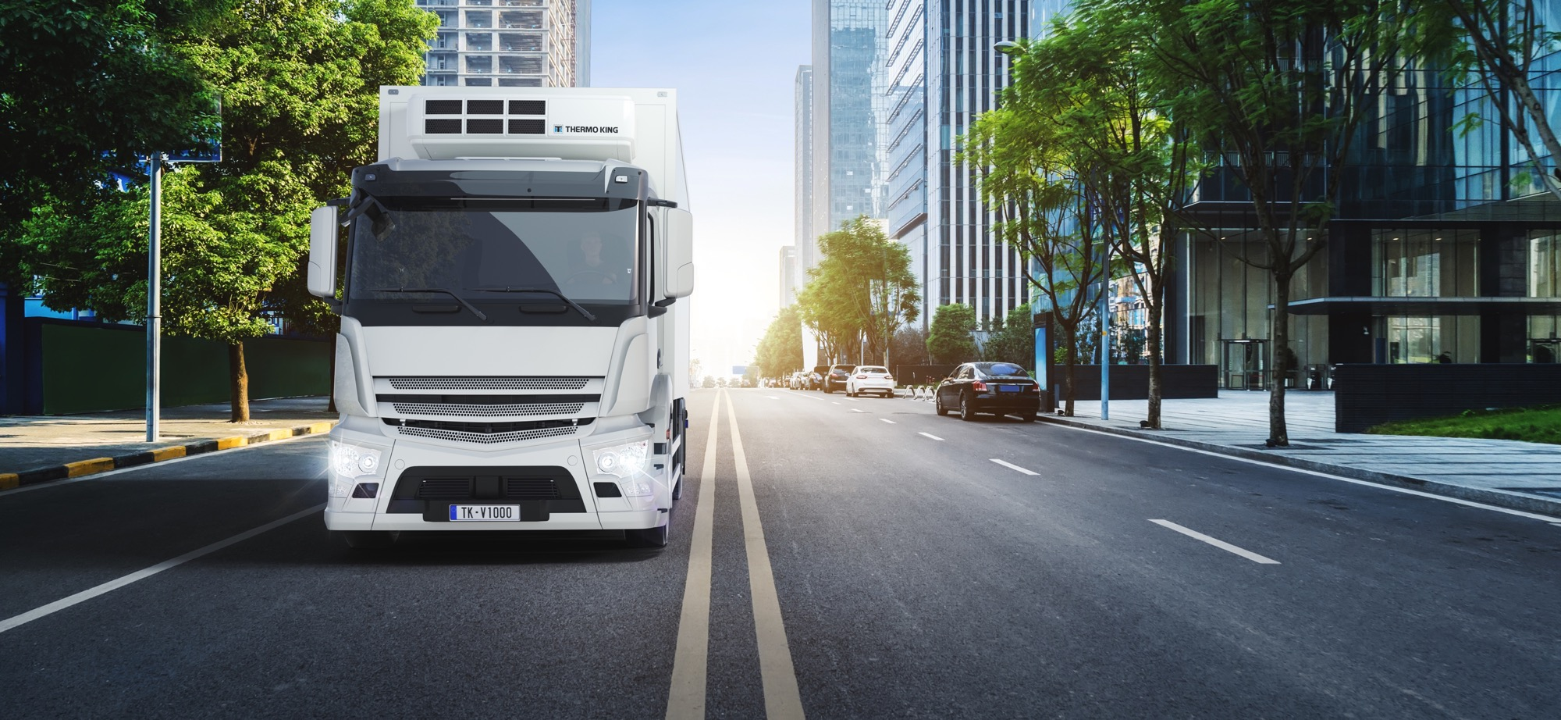

V-1000: A REVOLUTION IN LARGE TRUCK REFRIGERATION TECHNOLOGY
SINGLE- AND MULTI-TEMPERATURE
REFRIGERATION SOLUTIONS FOR LARGE TRUCKS

Slide 2
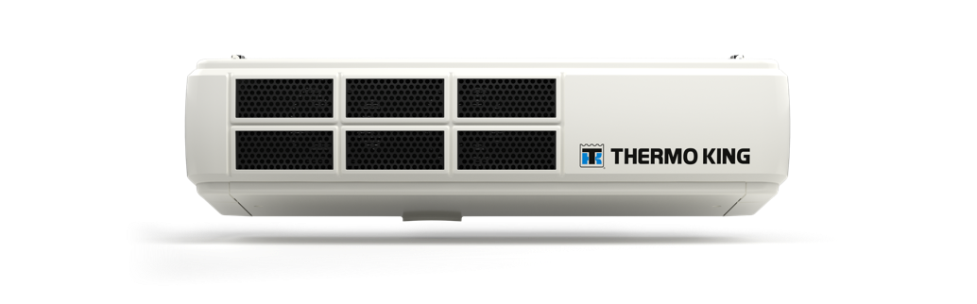

TABLE OF CONTENTS
  WHY V-1000?
  INTRODUCING V-1000: MORE CAPACITY, MORE FLEXIBILITY
  V-1000: IMPRESSIVE FACTS AND FIGURES
  V-1000: SPECIFICATIONS SINGLE TEMPERATURE
  V-1000: SPECIFICATIONS MULTI-TEMPERATURE
  V-1000: SPECIFICATIONS DIMENSIONS CONDENSER UNIT
  V-1000: SPECIFICATIONS DIMENSIONS EVAPORATORS

Slide 3


WHY V-1000?
HIGH POWER, LOW COST
VEHICLE-POWERED SOLUTION
The all-new V-1000 easily matches the performance of the leading diesel offerings
Low cost of operation, low weight and compact size of a vehicle-powered unit.
THERE’S A CHANGE COMING
Equipped with a compressor exclusively developed for Thermo King
Performance previously unattainable in units of this type.
Competitive initial investment compared to diesel powered unit
High cooling capacity and high airflow guarantee load protection
Total costs of ownership due to low maintenance costs and low fuel consumption.

Slide 4
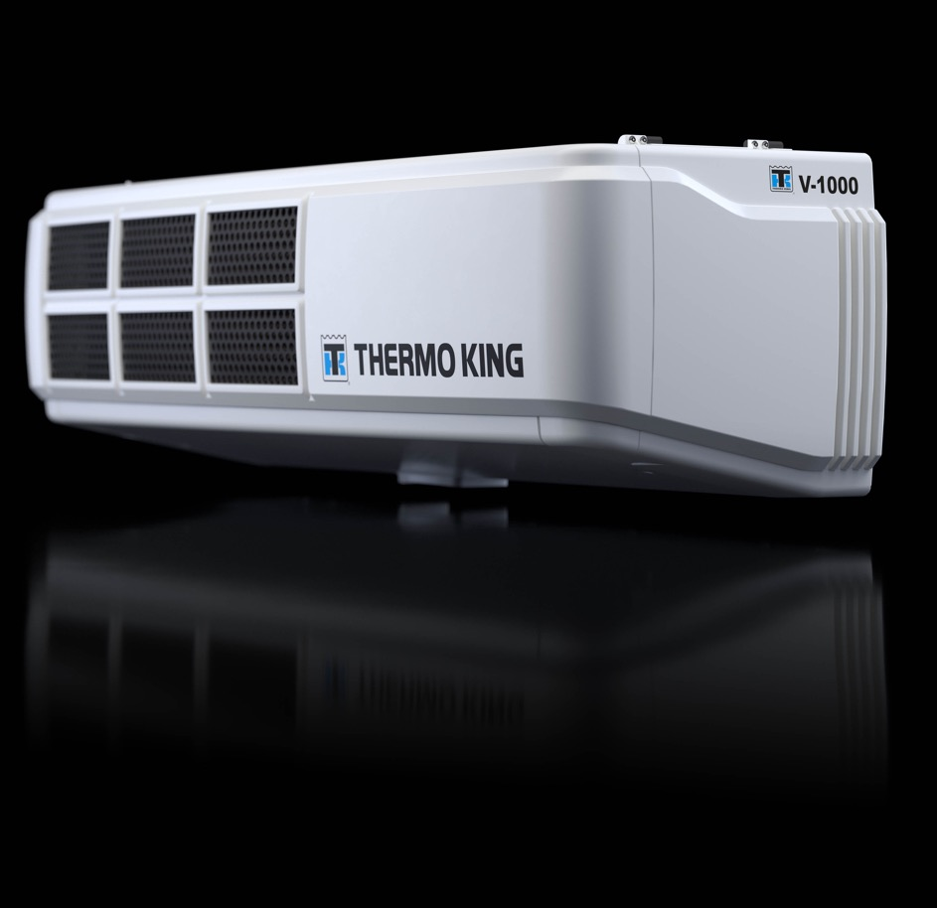

INTRODUCING V-1000
MORE CAPACITY, MORE FLEXIBILITY
Sustainability
These are just some of the key environmental benefits of this remarkable system:
No diesel emissions from the unit
No CO₂ emissions from the unit
Low noise when in operation
Less additional weight on the vehicle
More cargo carried per journey
Easily installed on progressive fleets using
LNG/CNG or bio-diesel.

Slide 5
INTRODUCING V-1000
MORE CAPACITY,
MORE FLEXIBILITY
Cost control
The V-1000 positively impacts Total Cost
of Operation (TCO) in these key areas:
Up to 54% less fuel consumption than
an equivalent self-powered system.
Maintenance costs including both parts
and labour are cut by up to 33%.
Load protection
The V-1000 features exceptional performance that competes directly with self-powered units and in many cases, even outperform them.

Slide 6
INTRODUCING V-1000
MORE CAPACITY,
MORE FLEXIBILITY
Productivity
The V-1000 is an exceptional performer when compared with an equivalent diesel unit:
Weight is less than half of an equivalent unit, savings 250 kg without standby and 150 kg with standby.
Exceptional Flexibility: single or various multi-temperature configurations.
Compact profile make it ideal for high cabs.
Compatible with multiple vehicle types including CNG, LNG or Biodiesel.
Available in both 12 V or 24 V.
Fit for trucks ranging from 3.5 Tn to 25 Tn depending on your application needs.

Slide 7
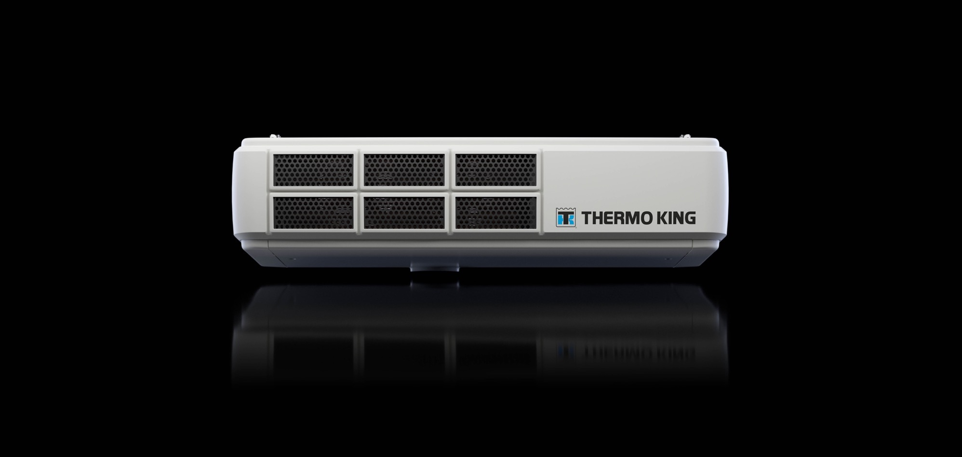
V-1000: IMPRESSIVE FACTS AND FIGURES
25%
31%
more powerful than its nearest diesel equivalent unit(s).
higher airflow than its nearest equivalent diesel unit(s).
57%
1.3x
higher standby capacity than its nearest diesel equivalent unit(s).
higher heating capacity than its nearest equivalent diesel unit(s).

Slide 8
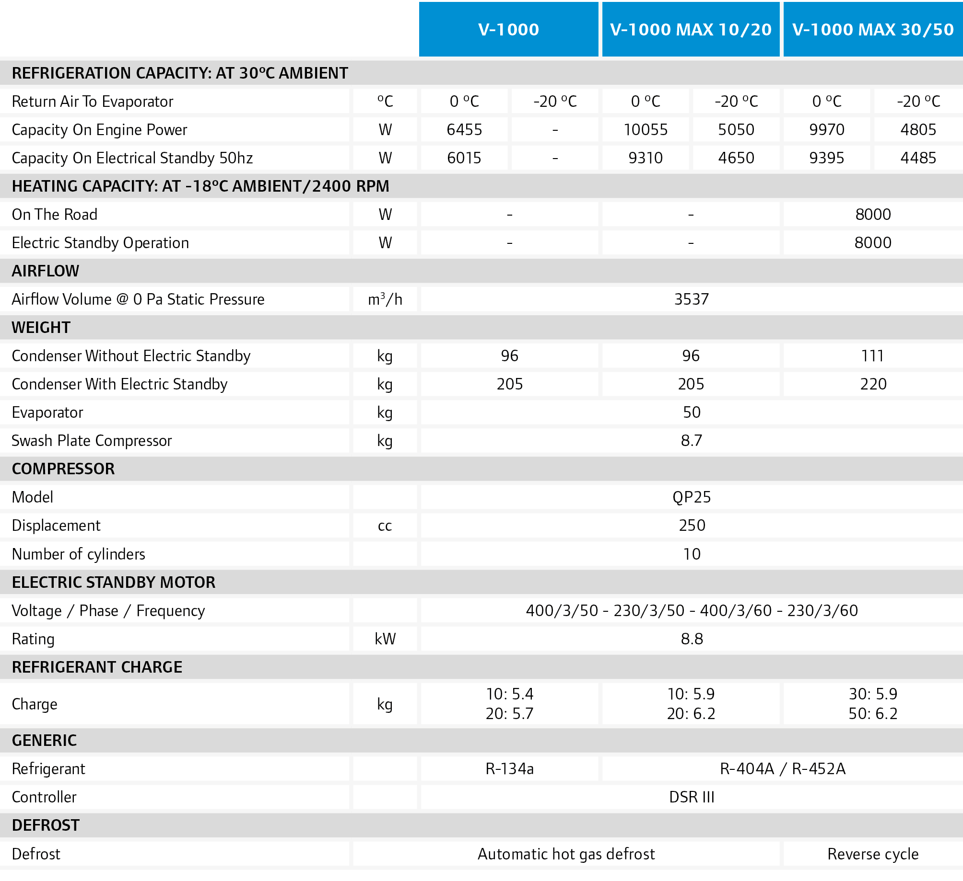
V-1000: SPECIFICATIONS – single temperature

Slide 9
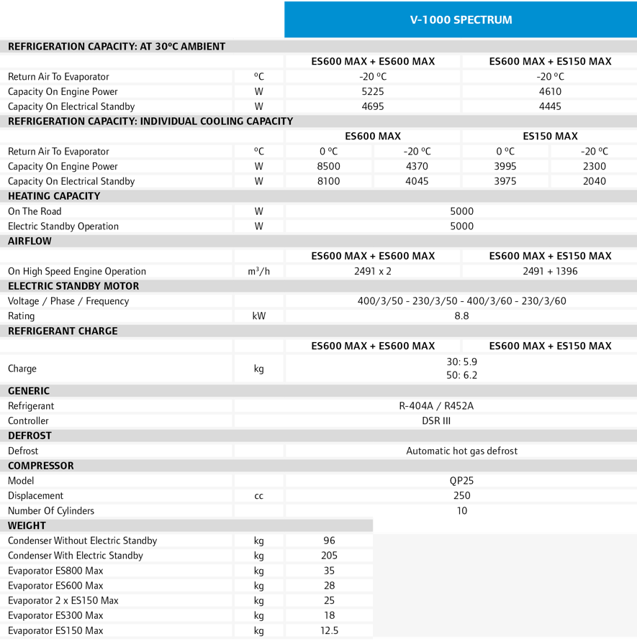
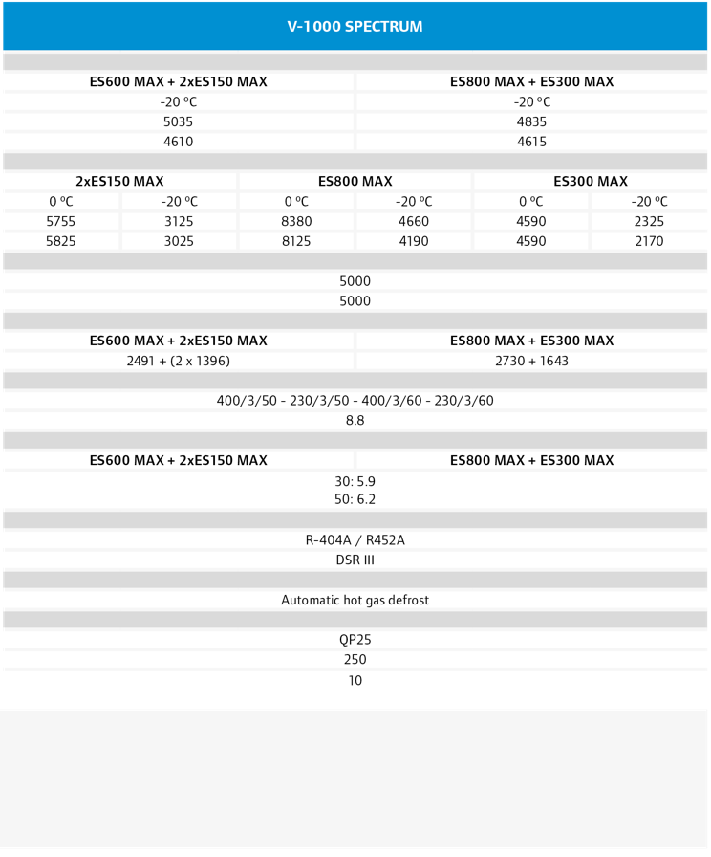
V-1000: SPECIFICATIONS – Multi- temperature

Slide 10
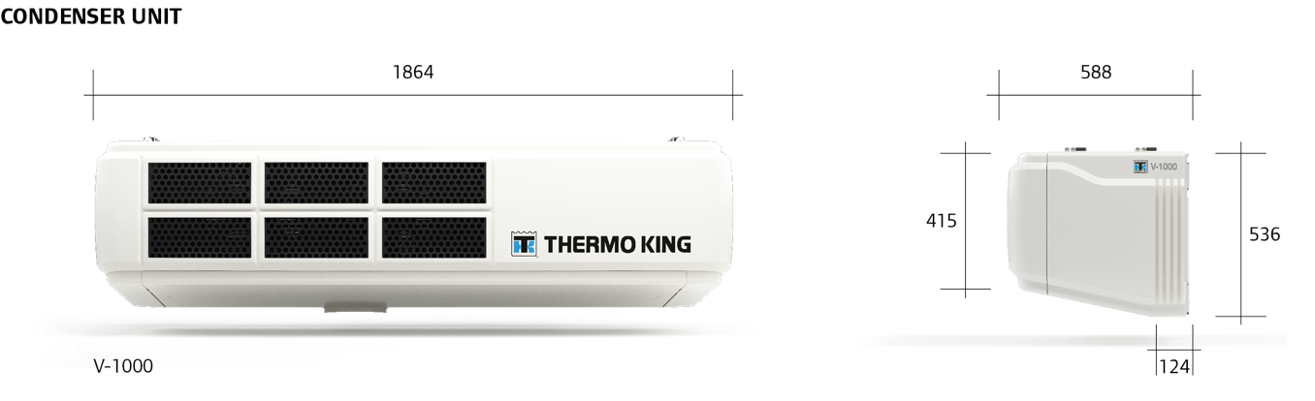
V-1000: SPECIFICATIONS – dimensions condenser

Slide 11
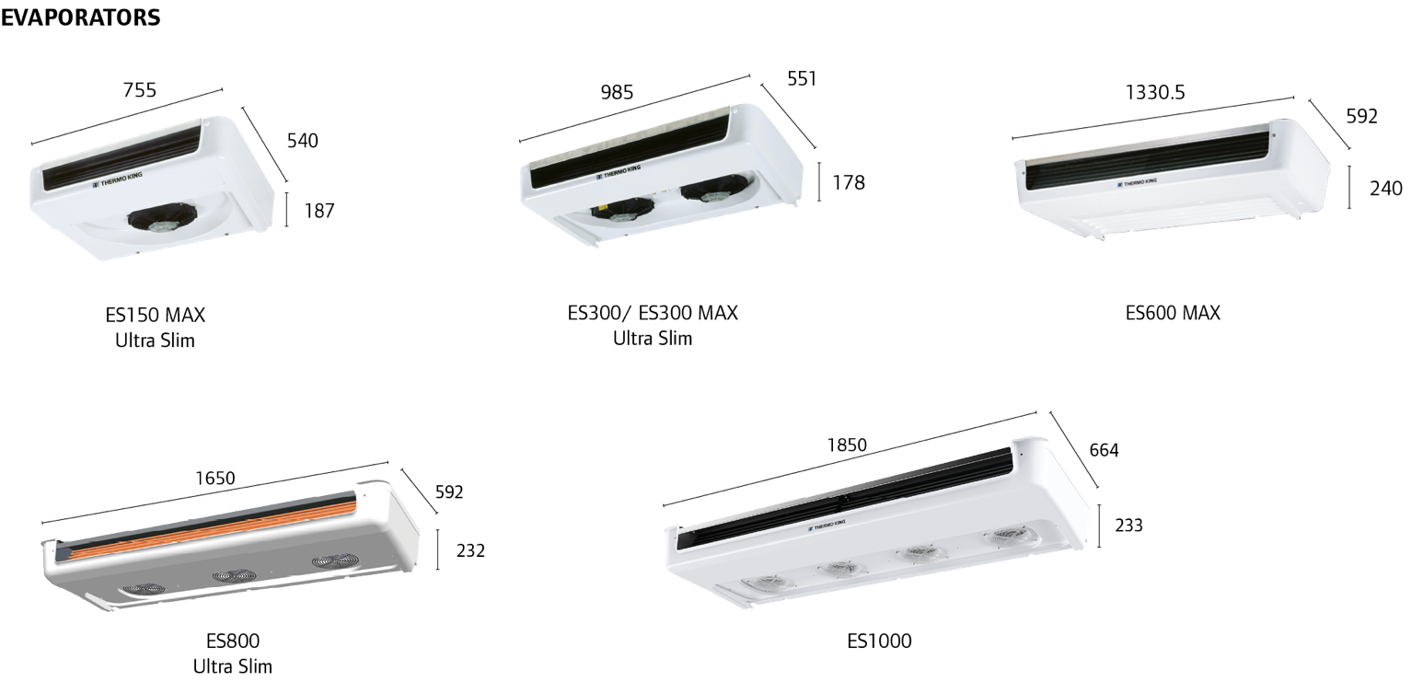
V-1000: SPECIFICATIONS – dimensions evaporators

Slide 12
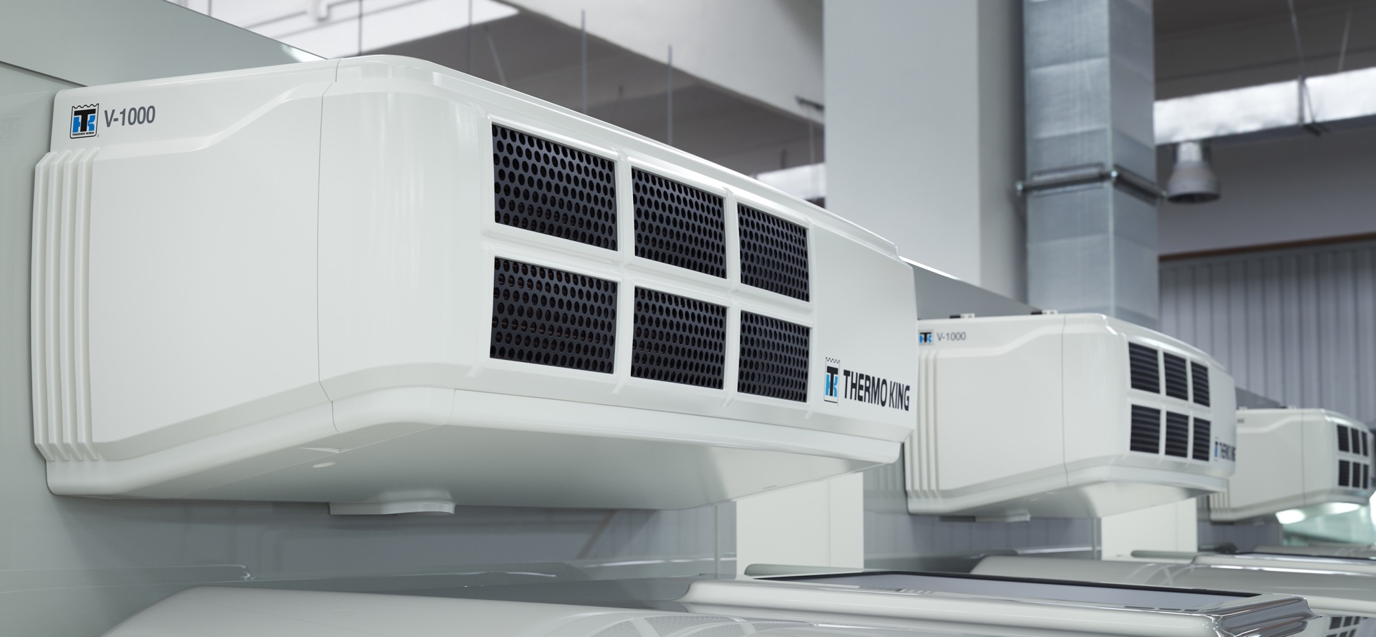
THANK YOU FOR YOUR ATTENTION!
V-1000
SINGLE- AND MULTI-TEMPERATURE
REFRIGERATION SOLUTIONS FOR LARGE TRUCKS

Slide 13

We appreciate comments , feedback, and any material useful to enrich our presentation.
E-mail us at:
marketing.europe@thermoking.com

